Slide 1
Introduction to Memory Management Strategies
Computer science students must grasp memory management as it affects system performance and resource usage. It involves memory allocation and deallocation in an effective way.
BY:
Leela Prasad(192210150)
T. Lokesh(192224105)
Dhanasekar (192210660)

Slide 2
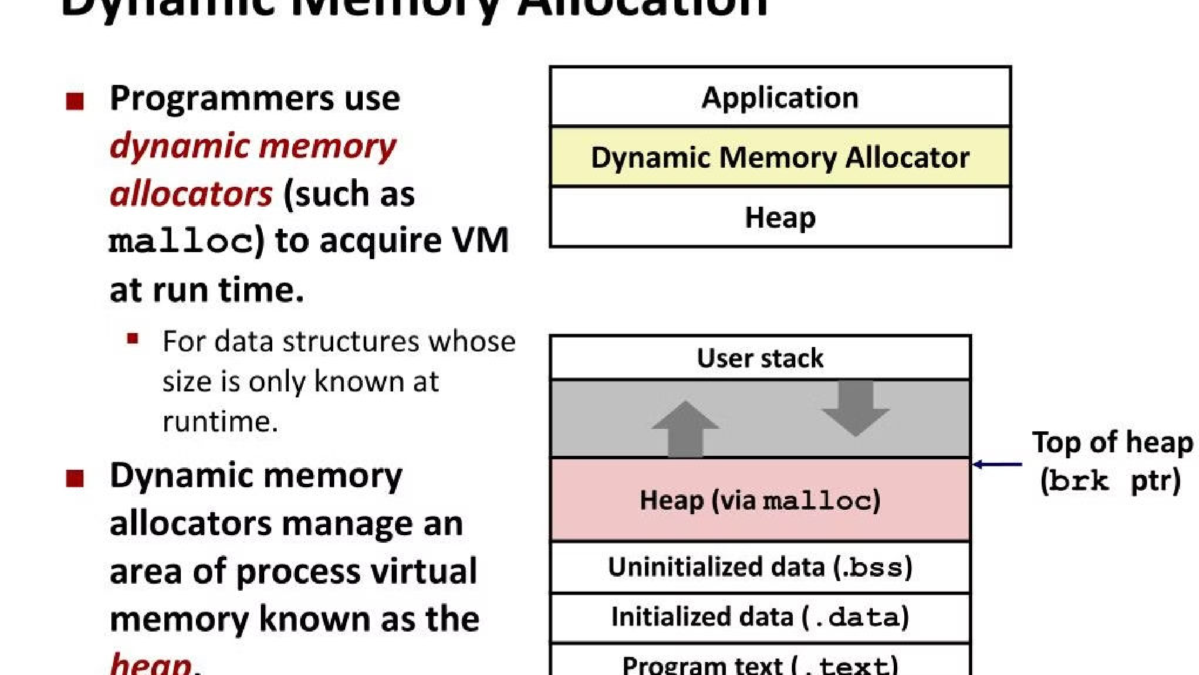
Overview of Best Fit, First Fit, and Worst Fit Strategies
1
Best Fit Strategy
Finds the smallest available partition that fits the process. Minimizes wastage but may result in fragmentation.
First Fit Strategy
2
Allocates the first available partition large enough to accommodate a process. Simple but can lead to external fragmentation.
3
Worst Fit Strategy
Allocates the largest available partition to a segment, leading to more wasted memory. Reduces the number of remaining holes but can cause slower performance.

Slide 3
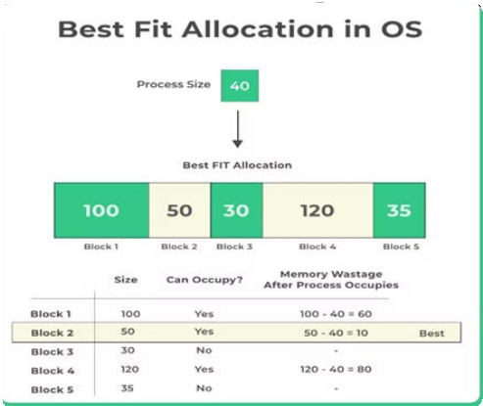

Explanation of Best Fit Strategy
1
Efficiency
Finds the smallest block that fits, minimizing internal fragmentation.
2
Complexity
More complex search algorithm, leading to slower allocation times.
3 Memory Utilization
Enhances overall memory utilization, reducing wastage.
4

Slide 4
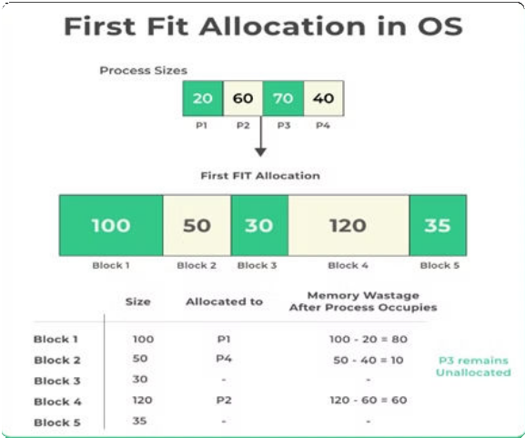
Explanation of First Fit Strategy
Simple Allocation
Allocates based on the first block that fits the process size.
1
Fragmentation Risk
Tends to create external fragmentation due to variable block sizes.
2
Memory Utilization
May lead to lower overall memory utilization.
3
4

Slide 5
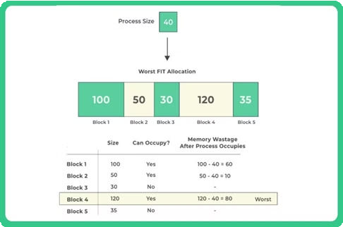
Explanation of Worst Fit Strategy
Memory Wastage
Performance Impact
Allocates the largest available partition, often leading to wasted memory.
Slower performance may be experienced due to increased wastage.

Slide 6
Comparison of Best, First and Worst-Fit Strategies
Best Fit
First Fit
Worst Fit
Minimizes wastage, but potential for internal fragmentation.
Simple allocation, but risk of external fragmentation.
Higher wastage, potential for slower performance.

Slide 7
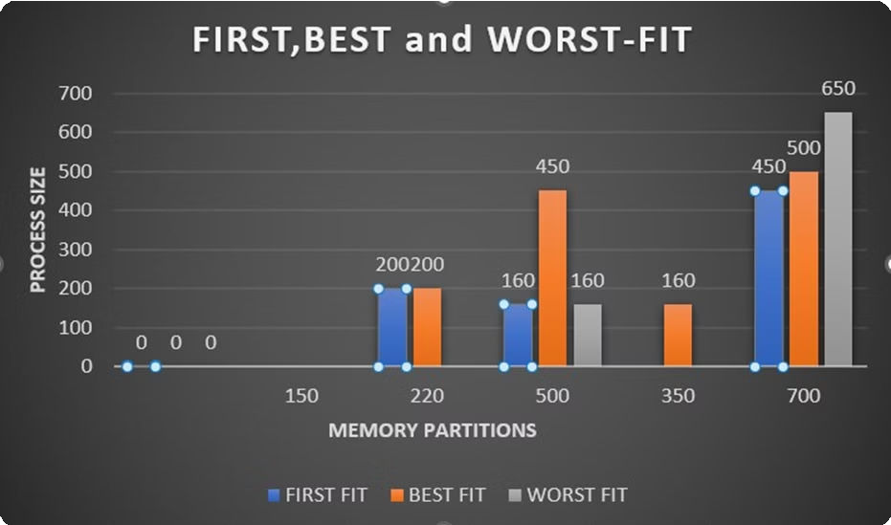
Result
The project "Memory Master" comprehensively analyzed memory allocation strategies—First Fit, Best Fit, and Worst Fit—under various conditions. Through practical implementation and experimentation, we evaluated their performance based on metrics such as fragmentation, overhead, and throughput. Results showed that while First Fit offers quick allocation with less computational work, it poses a risk of memory fragmentation. Best Fit minimizes memory waste but incurs higher computational overhead, whereas Worst Fit ensures sufficient memory for larger processes but may lead to significant memory waste.
—
—

Slide 8
Conclusion
Optimization
Trade-offs
Future Research
Choosing the right strategy is crucial for efficient memory management.
Each strategy has its advantages and trade-offs, impacting system
performance differently.
Continued research is essential to develop more effective memory management strategies.

Slide 9


